Slide 1
COM4012M – HTML5 & CSS3
Week 5 Lab Session 5

Slide 2
HTML5
HTML 5 is the new standard for HTML. So far, all of the HTML you have written is HTML5 compatible, however, a lot of it is based on the old HTML 4 language. HTML5, the new standard, adds new tags that increase the functionality of the language, and it also gets rid of some old tags that are superseded by the new ones, i.e. they are deprecated.

Slide 3
HTML5
The changes in HTML5 fall into four main areas:
1. The doctype and meta tags are slightly different.
2. New semantic elements: <header> <footer> <article> <section> <sidebar>
3. New multimedia elements: <audio>, <video>
4. New graphical elements: <canvas> <svg>
See here for obsolete (deprecated) features in HTML 5 https://www.w3.org/TR/html5/obsolete.html

Slide 4
DOCTYPE
The <!DOCTYPE> declaration must be the very first thing in your HTML document, before the <html> tag.
The <!DOCTYPE> declaration is not an HTML tag; it is an instruction to the web browser about what version of HTML the page is written in.
There are three different <!DOCTYPE> declarations in HTML 4.01. In HTML5 there is only one:
<!DOCTYPE html>

Slide 5
Metadata
Metadata is data (information) about data. Meta elements are typically used to specify page description, keywords, author of the document, last modified, and other metadata.
The <meta> tag provides metadata about the HTML document. HTML5 has a new attribute, charset, which makes it easier to define charset (character set):
HTML 4.01:< meta http-equiv="content-type" content="text/html; charset=UTF-8">
HTML5:< meta charset="UTF-8">
Other charsets include ASCII, ANSI & ISO, though use of UTF-8 is encouraged for web developers.

Slide 6
Semantic Elements Recap
If you recall back to Week 3, we covered the new tag equivalents of the <div> tag, which improve the code accessibility/readability of the page.
These were, but not limited to:
<header>
<footer>
<nav>
<section>
<article>
The other significant reason for the tags is to enable machine reading of the pages, so that they can, for example, be automatically processed (very important for search engines).

Slide 7
Semantic Elements Recap
The <header> element is for introductory content. Typically contains a title, a logo, authorship information, login field, search bar, & potentially a shopping cart.
The <footer> element is usually located at the bottom of the document/section. It often includes authorship information, copyright information, contact information, social media, sitemap, back to top links, & related documents.
The <nav> tag is for defining a set of navigation links. Not all navigation links need to be inside a <nav> element but should contain the major blocks of navigation links.
The <section> and <article> are for content, that are either all grouped and relate to a single theme or independent, self-contained content.

Slide 8
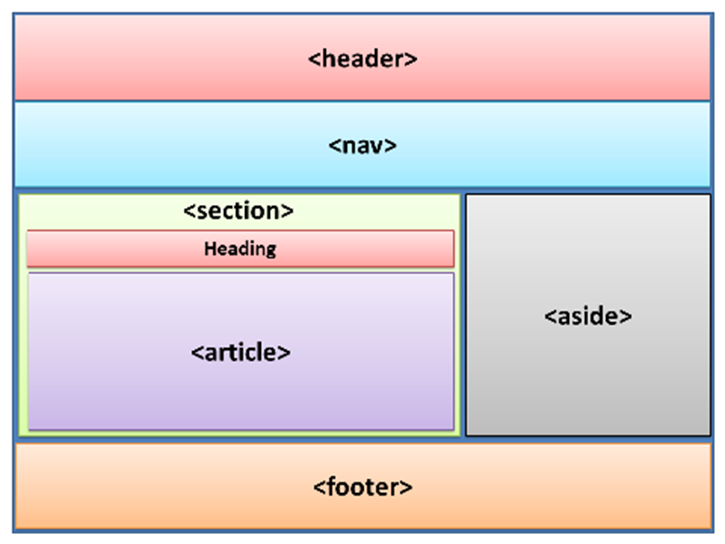
Semantic Elements Recap

Slide 9

Multimedia
Before HTML5, there was no standard for showing sound or video on a web page, they could only be played with a plug-in (like flash).
There are 2 new multimedia tags: < audio> and <video>
<audio controls>
<source src="horse.ogg" type="audio/ogg">
<source src="horse.mp3" type="audio/mpeg">
Your browser does not support the audio element.
</audio>
The controls attribute adds audio controls, like play, pause, and volume.
Text between the <audio> and </audio> tags will display in browsers that do not support the <audio> element.
Multiple <source> elements can link to different audio files. The browser will use the first recognized format.

Slide 10
Multimedia (Cont.)
<video width="320" height="240" controls>
<source src="movie.mp4" type="video/mp4">
<source src="movie.ogg" type="video/ogg">
Your browser does not support the video tag.
</video>
The controls attribute operates the same way as for audio. It is also a good idea to include width and height attributes. If height and width are not set, the browser does not know the size of the video. The effect will be that the page will change (or flicker) while the video loads.
Like audio, text between the <video> and </video> tags will only display in browsers that do not support the <video> element and multiple <source> elements can link to different video files. The browser will use the first recognized format.
If you wish to start a video automatically you can use the autoplay attribute:
<video width="320" height="240" autoplay>

Slide 11

Graphical Tags
The <canvas> tag is used to draw graphics, animations, enable interactivity and create games. The canvas can be written to and updated on the fly, via scripting (usually JavaScript).
The <canvas> tag is only a container for graphics, you must use a script to actually draw the graphics. Don’t forget to define the width and height for the size of the canvas.
<canvas id="myCanvas" width="300" height="150" style="border:1px solid grey"></canvas>
<script>
const myCanvas = document.getElementById("myCanvas");
const ctx = myCanvas.getContext("2d");
ctx.fillStyle = "red";
ctx.fillRect(20, 20, 150, 100);
</script>

Slide 12

Graphical Tags (Cont.)
SVG defines vector-based graphics in XML, which can be directly embedded in HTML pages. SVG graphics are scalable, and do not lose any quality if they are zoomed or resized:
<canvas id="myCanvas" width="300" height="150" style="border:1px solid grey"></canvas>
<svg width="100" height="100">
<circle cx="50" cy="50" r="40" stroke="green" stroke-width="4" fill="yellow" />
</svg>

Slide 13
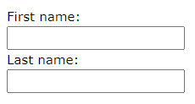
Forms Recap
One thing we touched on last week was Forms and adding JavaScript to them.
<form>
<label for="fname">First name:</label><br>
<input type="text" id="fname" name="fname"><br>
<label for="lname">Last name:</label><br>
<input type="text" id="lname" name="lname">
</form>

Slide 14
HTML5 Forms
In HTML5 the Input tag has been given increased functionality. These include, but not limited to:
autocomplete - on/off specific to autocomplete an element
autofocus - gets focus when a page loads
disabled - disables the input element
max/min - max/minimum value of an element
max/minlength - max/minimum length of characters
pattern - input has to adhere to a pattern
placeholder - provides a short hint to the expect value
readonly - input field can only be read
required - must be filled out
size - width of the input field
step - legal number of intervals for input field
value - default value of an input field

Slide 15
Example Forms
<form>
Enter a date before 1980-01-01:
<input type="date" name="bday" max="1979-12-31"><br>
Enter a date after 2000-01-01:
<input type="date" name="bday" min="2000-01-02"><br>
</form>
<form action="">
First name:<br>
<input type="text" name="firstname" value="John" readonly><br>
Last name:<br>
<input type="text" name="lastname">
</form>

Slide 16
CSS3
CSS3 is the current version of CSS and features improvements over CSS2, though remains backwards compatible.
CSS3 has new features such as new fonts, additional background features, improved borders, transitions and animations.

Slide 17
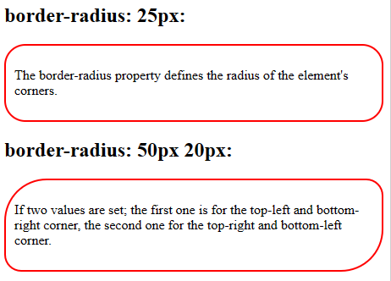
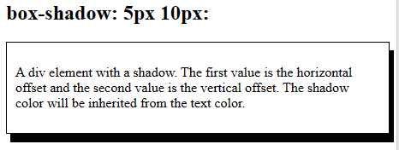
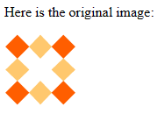

CSS3 Borders
A CSS3 Border enables the creation of rounded borders, border shadows, imaged based borders etc. There are three features to create the border:
border-radius, allows for adding rounded corners to borders.
box-shadow, allows for adding a shadow to a border.
border-image, stretches an image to be used as a border

Slide 18
CSS3 Columns
Multiple Columns are a feature of CSS3 which is used for creating a newspaper type layout.
There are three main properties of CSS3 Multiple Columns, which are as follows:
column-count
column-rule
column-gap
Where column-count defines the number of columns, column-rule defines the line style between the columns and the column-gap defines the gap (blank spaces) between the columns.

Slide 19
CSS3 Transitions
CSS transitions are a presentational effect that allow you to create property changes which occur on an event e.g. mouse-over or mouse-click.
The CSS3 introduces four new properties to transitions:
transition-property, which property or properties to target.
transition-duration, the duration of the given transition.
transition-timing-function, the timing function of the transition.
transition-delay, an optional possibility to delay the transition.

Slide 20
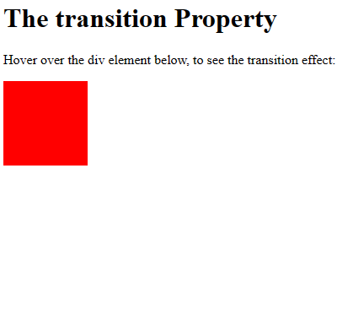
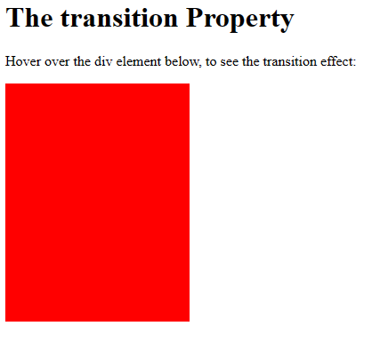
CSS3 Transitions
<style>
div {
width: 100px;
height: 100px;
background: red;
transition: width 2s, height 4s;
}
div:hover {
width: 300px;
height: 300px;
}
</style>

Slide 21
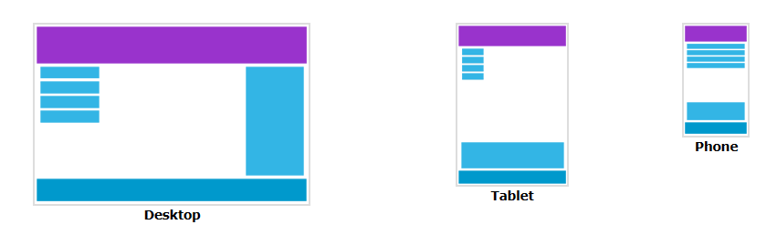
Responsive Web Design
Given the wide variety of potential screen sizes among users, having responsive web design is important so that your content remains visible regardless of the chosen device.
Responsive web design can be done using only HTML and CSS – no JavaScript is required.

Slide 22
Responsive Web Design
In HTML5, they introduced the viewport method to allow web designers take control over the viewport, through the <meta> tag.
Include this on all your pages to give your browser instructions to control the page’s dimensions and scaling:
<meta name="viewport" content="width=device-width, initial-scale=1.0">
The width=device-width part sets the width of the page to follow the screen-width of the device (which will vary depending on the device).
The initial-scale=1.0 part sets the initial zoom level when the page is first loaded by the browser.

Slide 23
Responsive Web Design
Most web pages are based on a grid view where pages are divided into columns:
.menu {
width: 25%;
float: left;
}
.main {
width: 75%;
float: left;
}

Slide 24
Responsive Web Design
Dividing your web pages into more columns grants you more control for responsive web design:
.col-1 {width: 8.33%;}
.col-2 {width: 16.66%;}
.col-3 {width: 25%;}
.col-4 {width: 33.33%;}
.col-5 {width: 41.66%;}
.col-6 {width: 50%;}
.col-7 {width: 58.33%;}
.col-8 {width: 66.66%;}
.col-9 {width: 75%;}
.col-10 {width: 83.33%;}
.col-11 {width: 91.66%;}
.col-12 {width: 100%;}

Slide 25
Responsive Web Design
You can then add breakpoints to the columns based on the size of the screen to make certain parts of the design behave differently either side of the breakpoint:
/* For mobile phones: */
[class*="col-"] {
width: 100%;
}
@media only screen and (min-width: 768px) {
/* For desktop: */
.col-1 {width: 8.33%;}
.col-2 {width: 16.66%;}
.col-3 {width: 25%;}
etc.

Slide 26
Responsive Web Design
Responsive web design can be quite exhaustive, but there are many templates online that you can use and w3schools has an excellent chapter on the full process.
https://www.w3schools.com/css/css_rwd_intro.asp

Slide 27
Sourced
www.w3schools.com

